Slide 1
Technical Answers for Real world Problems Course code: ECE3999 (UC) Marie Curie
VIT
Dr. SRS Prabaharan, Professor, SENSE

Slide 2
Group Members
NAMRATA CHAKKA – 15BEC1007
MADHURIMA MUKHERJEE - 15BEC1062
ANKITA NEGI – 15BEC1087
AYUSHI – 15BEC1190
ANJALI SINGH – 15BEC1218
PATURI HARSHITHA - 15BEC1243
ROHIT RAVINDRANATH JOSHI – 15BEC1051
ANISH ANDREWS KINGSLEY – 15BEC1071

Slide 3
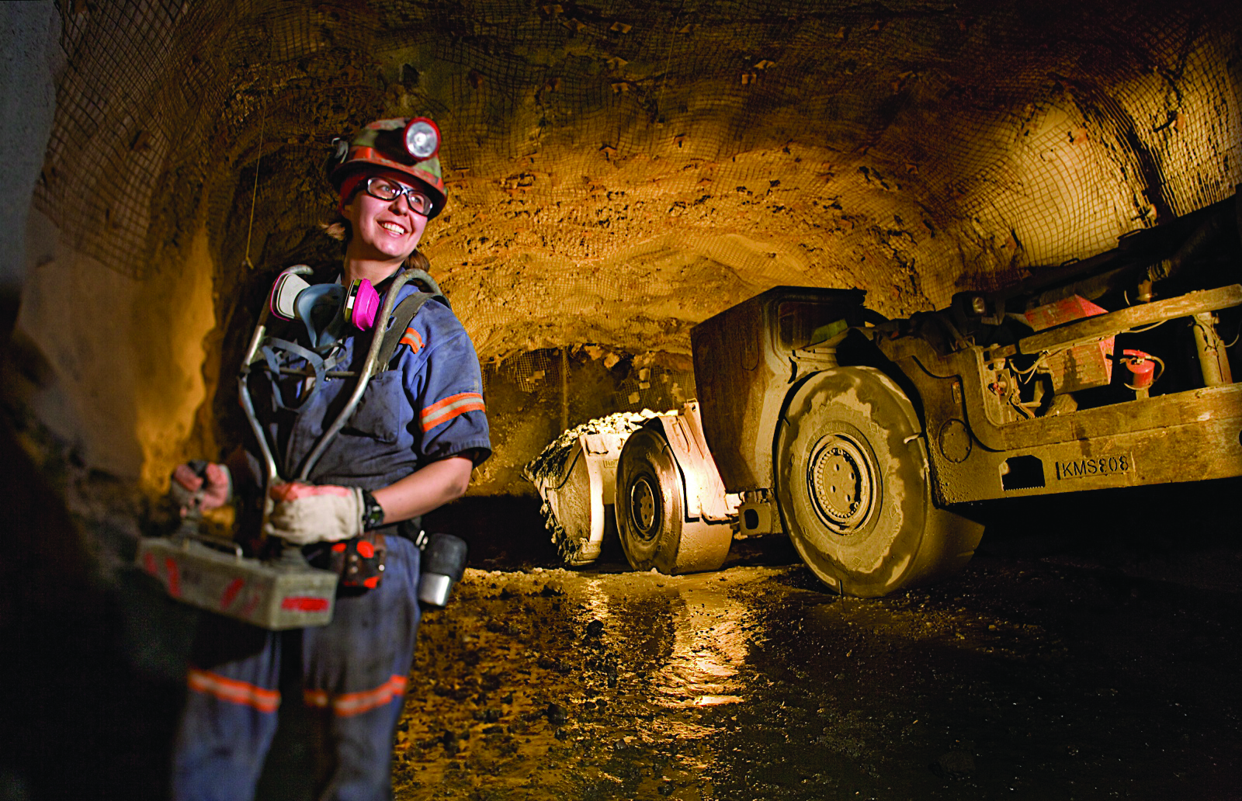
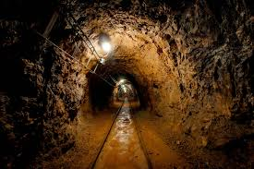
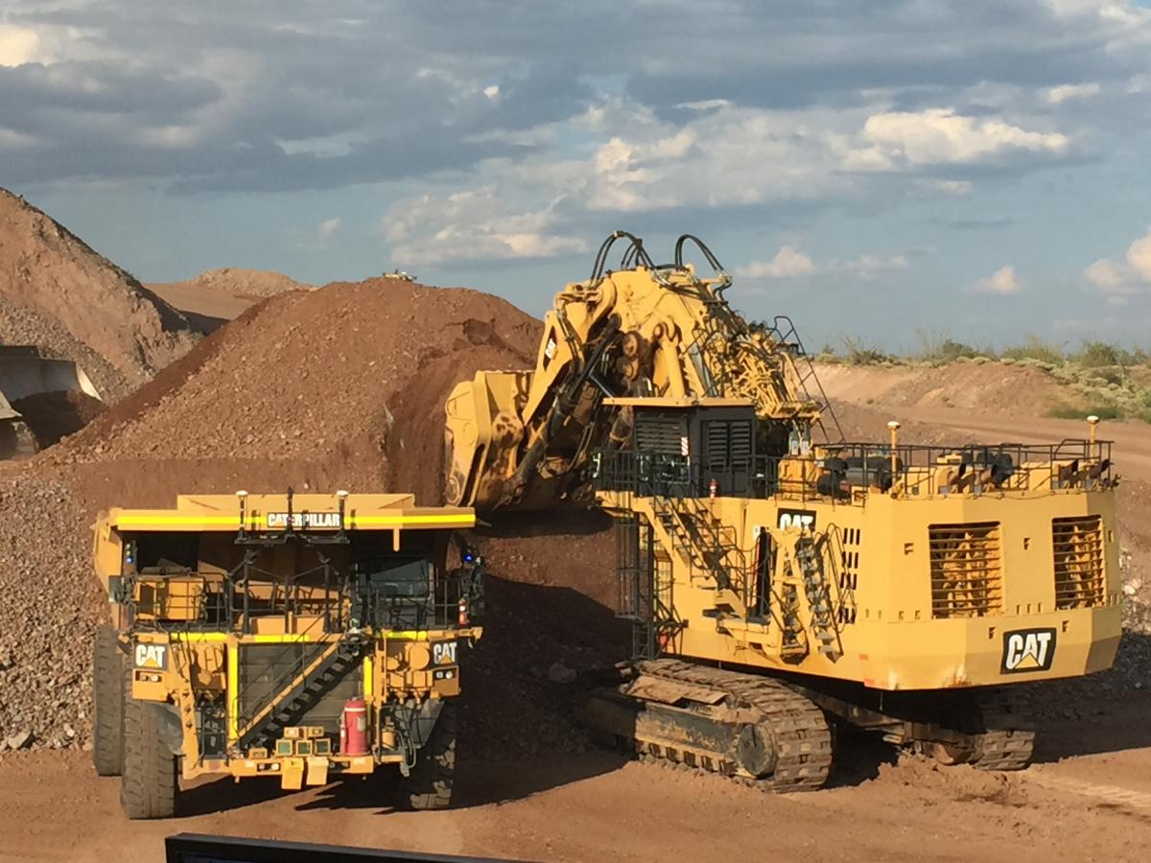
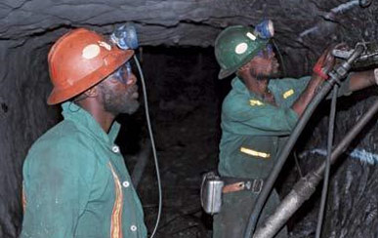
Safety System for Miners

Slide 4
Safety System for Miners
This project is designed to provide Intelligent Helmet for miners. For instance, various parameters like Methane gas, Carbon monoxide gas.
These sensors are fitted in the helmet of the coal miners. Whenever any parameter crosses a particular threshold value, a buzzer is turned on so as to indicate the miner about the danger. Thus this system performs function of miners safety monitoring and controlling system.
Interfacing a heart-beat sensor helps us monitor the health of the miner. The gas sensor interfaced gives us the methane content which when clubbed with the heart-beat value can give us the miners condition.

Slide 5
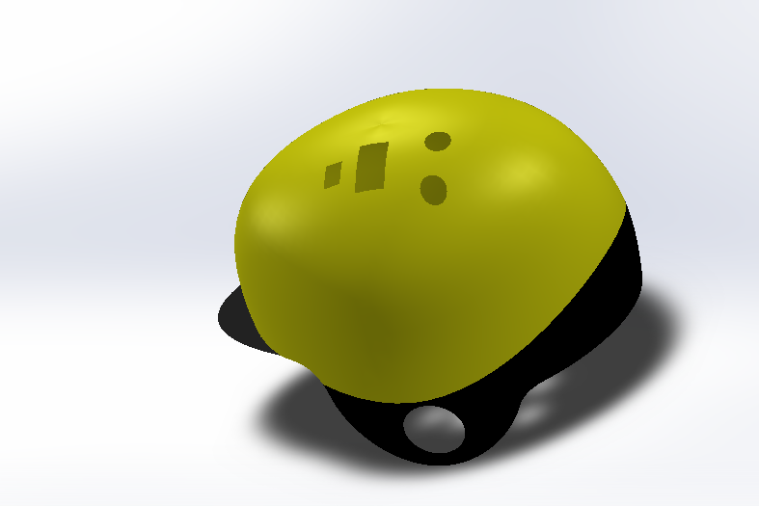
Basic View of Helmet
RF module (TX)
Gas sensor
battery

Slide 6
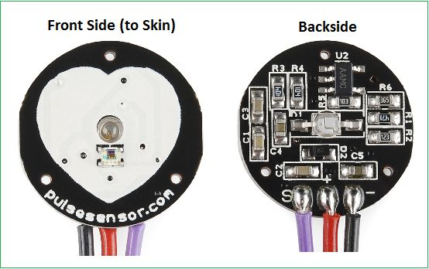
Components Specifications:
PULSE SENSOR
Pin configuration: + to +5V
- to GND
S to A0

Slide 7
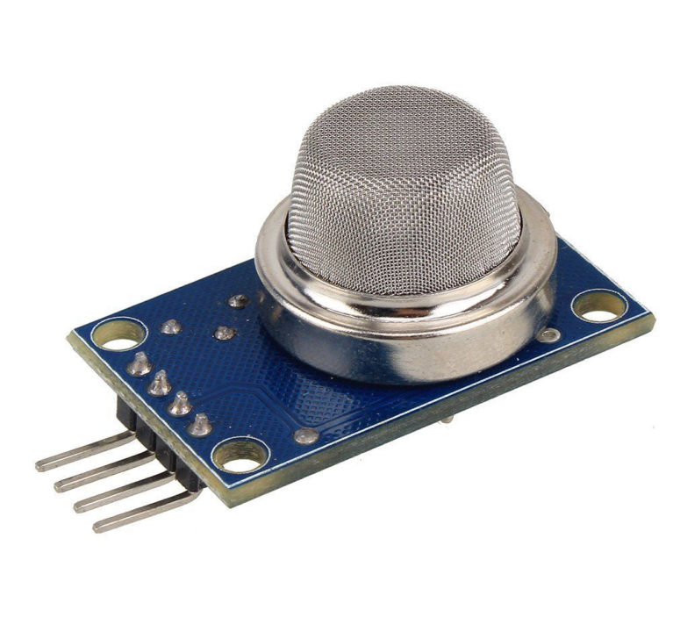
GAS SENSOR(MQ6)
Pin configuration: + to +5V
- to GND
S to A0
High sensitivity to methane, LPG
Small sensitivity to alcohol, smoke.
Fast response
Stable and long life
Simple drive circuit

Slide 8
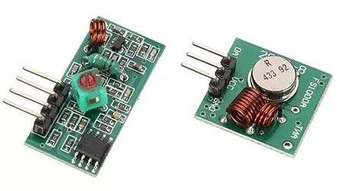
RF MODULE
Features of RF Module:
Receiver frequency 433MHz
Receiver typical frequency 105Dbm
Receiver supply current 3.5mA
Low power consumption
Receiver operating voltage 5v
Transmitter frequency range 433.92MHz
Transmitter supply voltage 3v~6v
Transmitter output power 4v~12v

Slide 9
BLOCK DIAGRAM
TRANSMITTER SIDE:
ARDUINO
UNO
GAS SENSOR
RF MODULE
PULSE SENSOR
BATTERY

Slide 10
RECEIVER SIDE:
ARDUINO UNO
BUZZER
RF MODULE
POWER SUPPLY

Slide 11
WORKING
When the worker enters the mine, he turns the helmet circuitry ON. The connection between helmet and control room is established through RF communication and is tested for proper communication.
The gas sensor detects poisonous gases like ethane, methane, butane, etc. and if such gases cross the set value,buzzer is turned ON. The values detected by the sensor are continuously transmitted through TX of RF module .
Similarly the pulse sensor transmits the heart beat rate of the miner through the rf module and the heart beat is monitored on the receiver side.

Slide 12
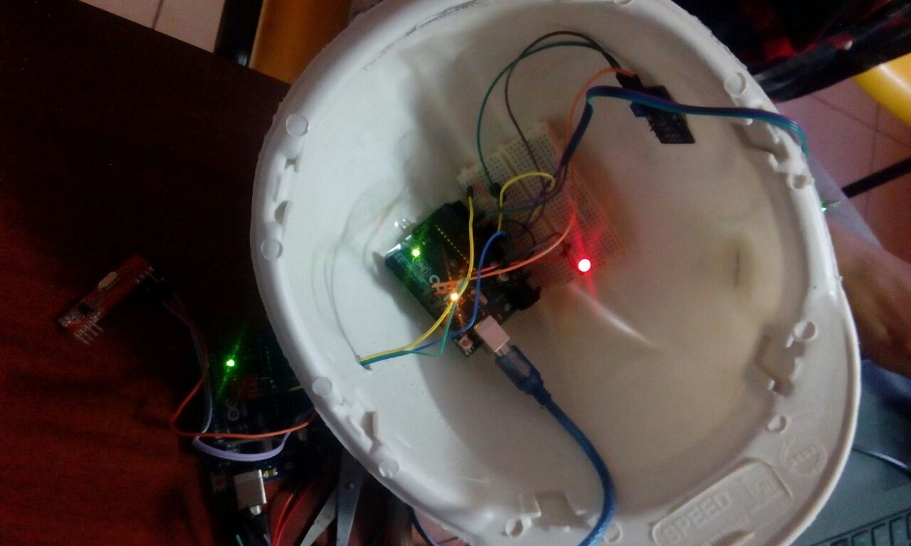
Prototype of helmet:

Slide 13

Output:
(on serial monitor)

Slide 14
